Slide 1
CHAPTER 13
FUZZY DECISION MAKING
“Principles of Soft Computing, 2nd Edition”
by S.N. Sivanandam & SN Deepa
Copyright © 2011 Wiley India Pvt. Ltd. All rights reserved.

Slide 2
FUZZY DECISION MAKING
Decision making is a very important social, economical and scientific endeavor.
The decision-making process involves three steps:
  1. Determining the set of alternatives,
  2. Evaluating alternatives,
  3. Comparison between alternatives.
“Principles of Soft Computing, 2nd Edition”
by S.N. Sivanandam & SN Deepa
Copyright © 2011 Wiley India Pvt. Ltd. All rights reserved.

Slide 3
Certain fuzzy decision-making process are as follows:
Individual decision making,
Multiperson decision making,
Multiobjective decision making,
Multiattribute decision making,
Fuzzy Bayesian decision making.
“Principles of Soft Computing, 2nd Edition”
by S.N. Sivanandam & SN Deepa
Copyright © 2011 Wiley India Pvt. Ltd. All rights reserved.

Slide 4
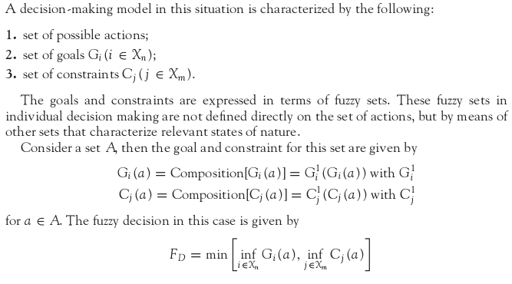
INDIVIDUAL DECISION MAKING
“Principles of Soft Computing, 2nd Edition”
by S.N. Sivanandam & SN Deepa
Copyright © 2011 Wiley India Pvt. Ltd. All rights reserved.

Slide 5
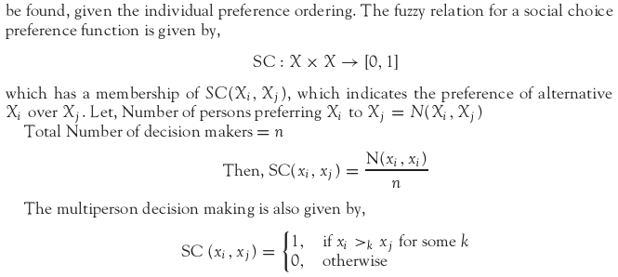
MULTIPERSON DECISION MAKING
In multiperson decision making, the decision makers have access to different information upon which to base their decision.
“Principles of Soft Computing, 2nd Edition”
by S.N. Sivanandam & SN Deepa
Copyright © 2011 Wiley India Pvt. Ltd. All rights reserved.

Slide 6
MULTIOBJECTIVE DECISION MAKING
In making a decision when there are several objectives to be realized, then the decision making is called multiobjective decision making.
Many decision processes may be based on single objectives such as cost minimization, time consumption, profit maximization and so on.
The main issues in multiobjective decision making are:
To acquire proper information related to the satisfaction of the objectives by various alternatives.
To weigh the relative importance of each objective.
“Principles of Soft Computing, 2nd Edition”
by S.N. Sivanandam & SN Deepa
Copyright © 2011 Wiley India Pvt. Ltd. All rights reserved.

Slide 7
MULTIATTRIBUTE DECISION MAKING
The evaluation of alternatives can be carried out based on several attributes of the object called multiattribute decision making.
The attributes may be classified into numerical data, linguistic data and qualitative data.
“Principles of Soft Computing, 2nd Edition”
by S.N. Sivanandam & SN Deepa
Copyright © 2011 Wiley India Pvt. Ltd. All rights reserved.

Slide 8
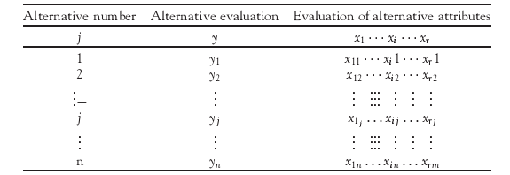
MULTIATTRIBUTE DECISION MAKING
The problem of decision-making structure in multiattributes deals with determination of an evaluation structure for the multiattribute decision making from the available multiattribute data xi (i = 1 to n) and alternative evaluations y shown in the table.
“Principles of Soft Computing, 2nd Edition”
by S.N. Sivanandam & SN Deepa
Copyright © 2011 Wiley India Pvt. Ltd. All rights reserved.

Slide 9
FUZZY BAYESIAN DECISION MAKING
Probability theory.
Bayesian inference:
  Use probability theory and information about independence.
  Reason diagnostically [from evidence (effects) to conclusions (causes)] or casually (from causes to effects).
Bayesian networks:
  Compact representation of probability distribution over a set of propositional random variables.
  Take advantage of independence relationships.
“Principles of Soft Computing, 2nd Edition”
by S.N. Sivanandam & SN Deepa
Copyright © 2011 Wiley India Pvt. Ltd. All rights reserved.

Slide 10
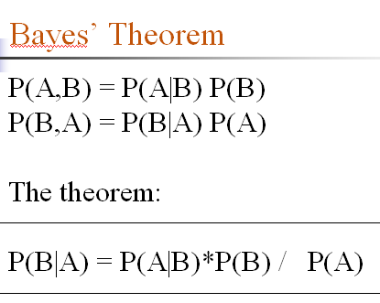
FUZZY BAYESIAN DECISION MAKING
“Principles of Soft Computing, 2nd Edition”
by S.N. Sivanandam & SN Deepa
Copyright © 2011 Wiley India Pvt. Ltd. All rights reserved.

Slide 11
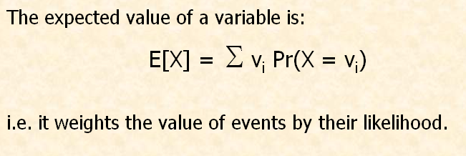
Expected Utility
“Principles of Soft Computing, 2nd Edition”
by S.N. Sivanandam & SN Deepa
Copyright © 2011 Wiley India Pvt. Ltd. All rights reserved.

Slide 12
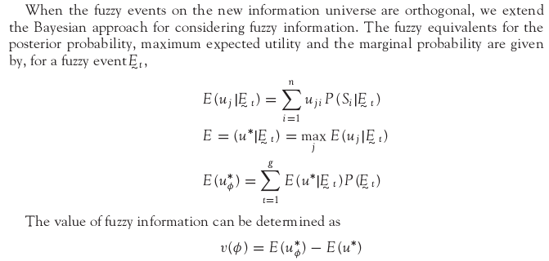
“Principles of Soft Computing, 2nd Edition”
by S.N. Sivanandam & SN Deepa
Copyright © 2011 Wiley India Pvt. Ltd. All rights reserved.

Slide 13
SUMMARY
The chapter has discussed the various decision-making process.
In many decision-making situations, the goals, constraints and consequences of the defined alternatives are known imprecisely, which is due to ambiguity and vagueness.
Methods for addressing this form of imprecision are important for dealing with many of the uncertainties we deal within human systems.
“Principles of Soft Computing, 2nd Edition”
by S.N. Sivanandam & SN Deepa
Copyright © 2011 Wiley India Pvt. Ltd. All rights reserved.

